Slide 1


Devam Singh
13-06-24
MY GITHUB- https://github.com/Devamsingh09

Slide 2

Outline
Executive Summary
Introduction
Methodology
Results
Conclusion
Appendix

Slide 3
Executive Summary
Methodology Summary
We performed CRISP-DM (Cross-Industry Standard Process for Data Mining) Methodology
Here's how the CRISP-DM methodology is generally applied :
Business Understanding
Data Understanding
Data Preparation
Modeling
Evaluation
Deployement
Feedback

Slide 4
Introduction
Project background and context
In this report, we predicted if the Falcon 9 first stage will land successfully. SpaceX advertises Falcon 9 rocket launches on its website, with a cost of 62 million dollars; other providers cost upward of 165 million dollars each, much of the savings is because SpaceX can reuse the first stage. Therefore if we can determine if the first stage will land, we can determine the cost of a launch. This information can be used if an alternate company wants to bid against SpaceX for a rocket launch.
Problems you want to find answers
What sources we used to gather information about SpaceX, and how did we clean and prepared this data for analysis?
What are the key metrics and variables we collected about SpaceX's missions and first-stage landings?
Can we provide a summary of the data, including the number of missions, success rates, and any trends or patterns observed?

Slide 5
Introduction
Problems you want to find answers
Describe the process of building and training the machine learning model to predict if SpaceX will reuse the first stage.
Can you explain the choice of the machine learning algorithm(s) used for this prediction task?
How did you evaluate the performance of the model, and what metrics did you use to assess its accuracy?
How confident is the model in its predictions, and what are the implications of these predictions for SpaceX's operations?
Based on the model's insights, what recommendations would you provide to SpaceX regarding their first-stage reuse strategy?
Were there any limitations or challenges faced during the model-building process, and how were they addressed?

Slide 6

Section 1

Slide 7
Methodology
Executive Summary
Data collection methodology:
The capstone assignment involves working with SpaceX launch data obtained from the SpaceX REST API. This API provides information about launches, including details about the rocket used, payload delivered, launch specifications, landing specifications, and a summary of the landing outcome.
Perform data wrangling
The dataset contains Flight Number, Date, Booster version, Payload mass, Orbit, Launch Site, Outcome (landing status), Grid Fins, Reused, Legs, Landing pad, Block, Reused count, Serial, and Longitude/Latitude. Launch sites: Vandenberg AFB, Kennedy Space Center, CCAFS SLC 40. Orbits: LEO, GTO. "Outcome" shows successful ("True ASDS") or unsuccessful ("False ASDS") first-stage landings, to be converted to binary (0 for unsuccessful, 1 for successful) for "Y."

Slide 8
Methodology
Perform exploratory data analysis (EDA) using visualization and SQL
In the project, will determine what attributes are correlated with successful landings.
The categorical variables will be converted using one hot encoding, preparing the data
for a machine learning model that will predict if the first stage will successfully land.
Perform interactive visual analytics using Folium
With interactive visual analytics, users could find visual patterns faster and more effectively.
Instead of presenting our findings in static graphs, interactive data visualization, or
dashboarding, can always tell a more appealing story.
In this project, will be using Folium.
Perform predictive analysis using classification models
We will test Logistic Regression, Support Vector machines,
Decision Tree Classifier, and K-nearest neighbors.
Finally, we will output the confusion matrix.

Slide 9
Data Collection
Describe how data sets were collected.
In this analysis, we will review Collecting the Data with an API.
In this assignment, we will be working with SpaceX launch data that is gathered from
an API, specifically the SpaceX REST API.
This API will give us data about launches, including information about the rocket used,
payload delivered, launch specifications, landing specifications, and landing outcome.
Our goal is to use this data to predict whether SpaceX will attempt to land a rocket or not.
The SpaceX REST API endpoints, or URL, starts with api.spacexdata.com/v4/.

Slide 10
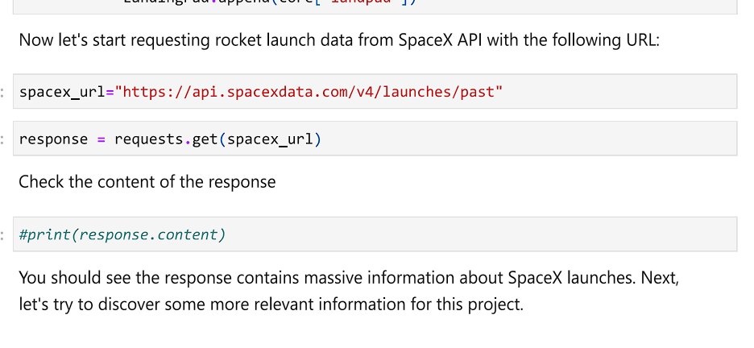
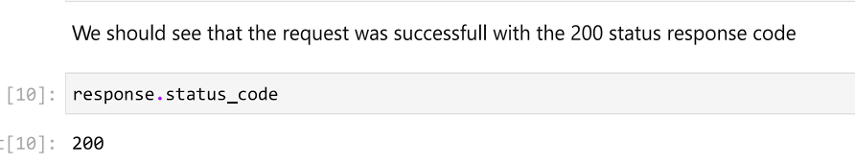
Data Collection – SpaceX API
Using spacex URL we are putting it in spacex_url variable and generating the response through requests.get method.
We can see API is working properly as resulted response code i.e. 200.
API_URL: https://api.spacexdata.com/v4/launches/past
Place your flowchart of SpaceX API calls here

Slide 11
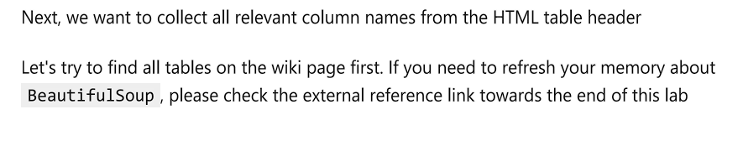
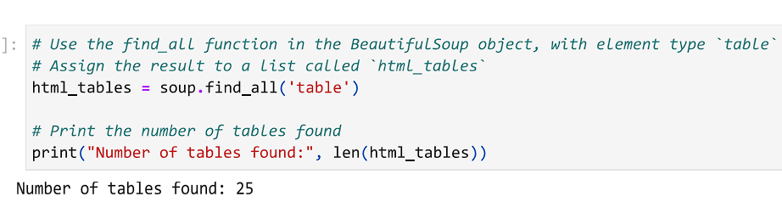
Data Collection - Scraping
After generating response we used BeautifulSoup for webscrapping. Here we extracted various tables and their <Th> elements .
We created empty dictionaries with keys from extracted columns and made new dataframe.
WebScrapping:https://github.com/Devamsingh09/SPACE_X_FALCON9.github.io/blob/main/2_SPACE_Xwebscrapping.ipynb
Place your flowchart of web scraping here

Slide 12
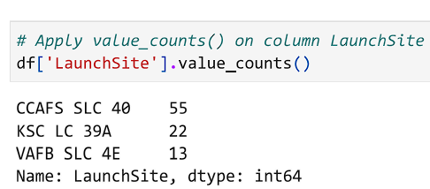
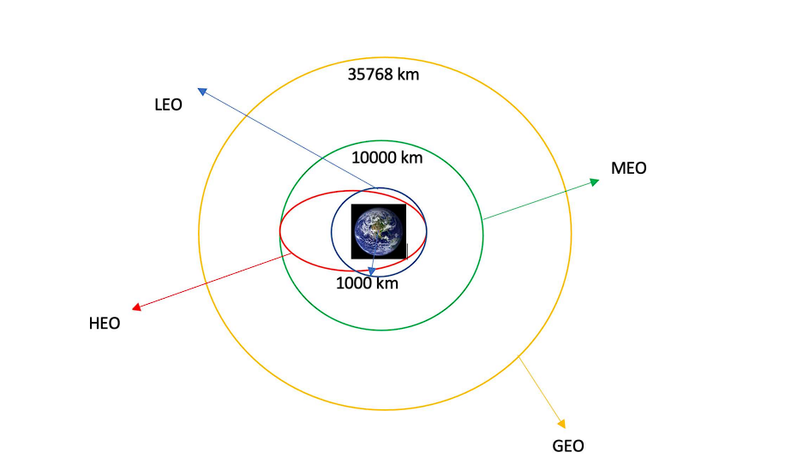
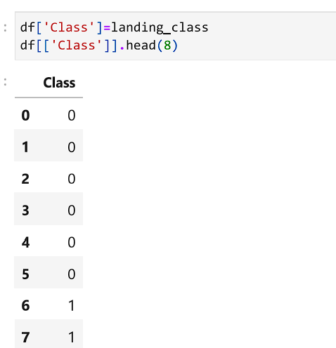
Data Wrangling
How data were processed:
We would like landing outcomes to be converted to Classes y. y. (either 0 or 1). 0 is a bad outcome, that is, the booster did not land. 1 is a good outcome, that is, the booster did land. The variable Y will represent the classification variable that represents the outcome of each launch.
Calculating Num of Launches of each site: Here are some common dedicated orbits
Using the outcome we created a list where the
Element is 0 if the corresponding row in outcome is in the
Set bad outcome (i.e. its class value is 0)
DataWrangling: https://github.com/Devamsingh09/SPACE_X_FALCON9.github.io/blob/main/3_Spacex-Data%20wrangling.ipynb

Slide 13
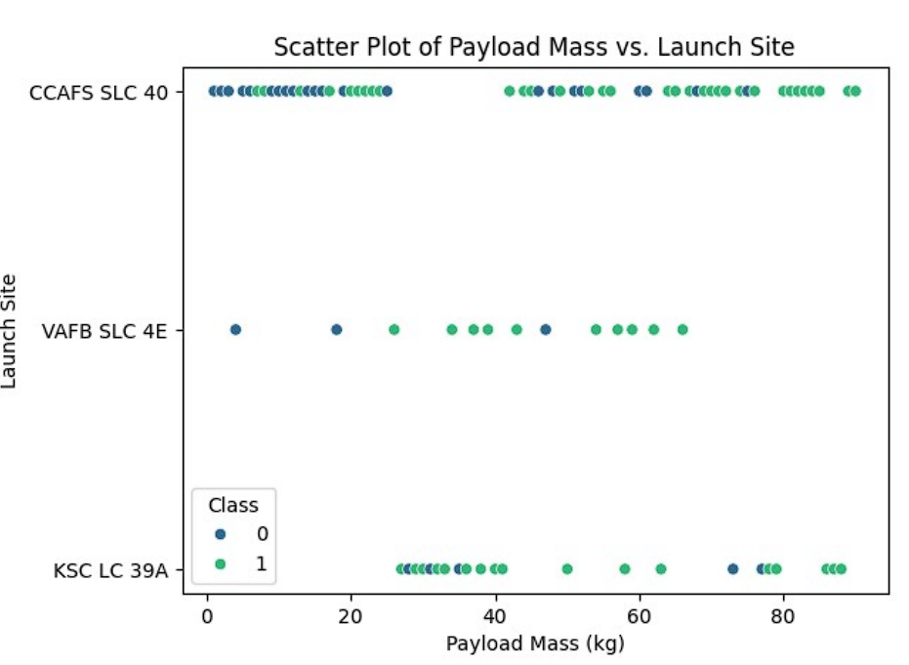
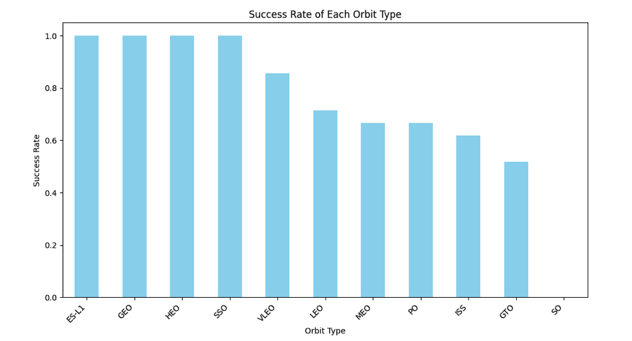
EDA with Data Visualization
We used mainly cat plot and scatterplot to find out the relationships between Payload Mass, Flight Num, Launch Site. We also plot bar chart with orbit success rate of all the orbits to find the most suitable orbit for future purpose.
EDA GITHUB Link: https://github.com/Devamsingh09/SPACE_X_FALCON9.github.io/blob/main/5_Exploratory_Data_Analysis.ipynb

Slide 14
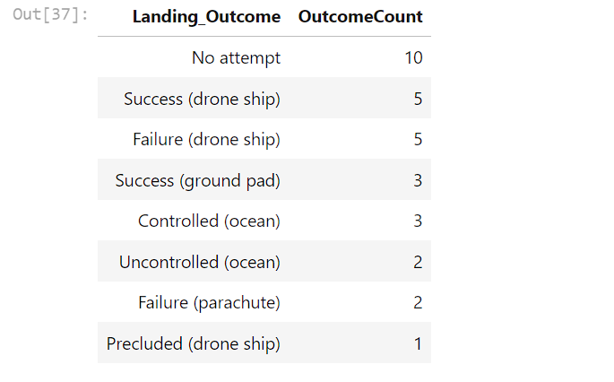
EDA with SQL
We selected distinct Launch Site from SpaceX Table
Selected Data Whose Launch Site Starts with something CCA i.e. CCAFS LC-40 and CCAFS SLC-40
Selected AVG Pay Load Mass from Table where booster version is F9 V1.1.
Selected first successful landing date where landing outcome is TRUE RTLS.
Selected first successful landing date where landing outcome is TRUE RTLS and Pay Load > 4000.
Selected list of cases where launch is successful assigning it as 1 else 0.
Here are the Outcomes of the analysis:
For more:
SQL EDA GITHUB Link:
https://github.com/Devamsingh09/SPACE_X_FALCON9.github.io/blob/main/4_SQL_statements.ipynb

Slide 15
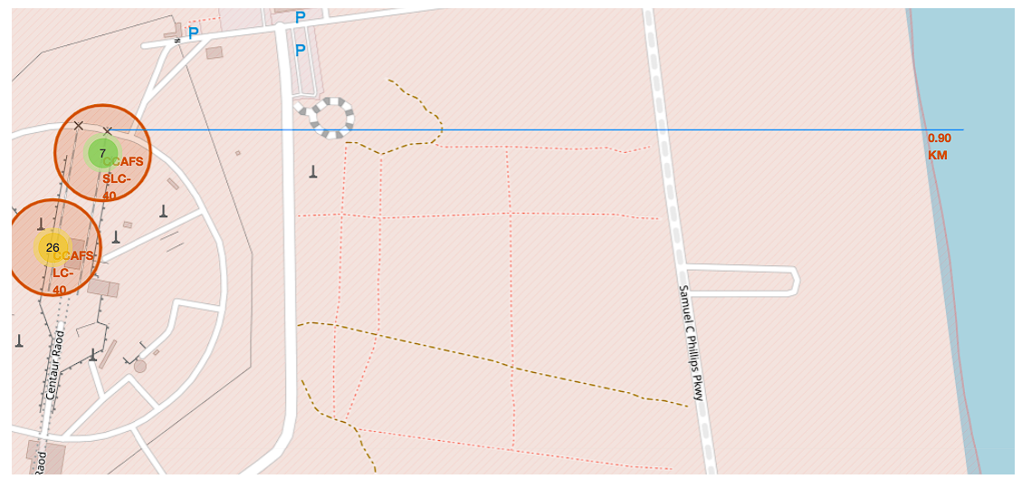
Build an Interactive Map with Folium
We added folium circle and folium map marker to the all the launch sites of data to understand the launching sites quickly.
We added marker cluster for better visualization and also coordinates for nearest highway, city and railway along with distance for convenience of readers.
For more:
Folium GITHUB Link:
https://github.com/Devamsingh09/SPACE_X_FALCON9.github.io/blob/main/6_Mapping_and_location_uisng_folium.ipynb

Slide 16
Predictive Analysis (Classification)
Firstly, we used logistic regression and created Grid SearchCV object we fit logistic regression in GridSearch along with training dataset in which our target is ‘Class’ that is successfully launched or not. Got the accuracy of 83%.
Then we created a support vector machine and grid search object to find best parameters. This time we got 81% accuracy.
We also created confusion matrix to understand the prediction accuracy of model.
After we created decision tree classifier which provided the accuracy of 88%.
Then we created KNN Classifier and Grid Search for best parameters and got 61% accuracy.
Hence, we found our decision tree accuracy as best which is about 88%.
For more findings and outputs:
ML ALGORITHMS GITHUB Link: https://github.com/Devamsingh09/SPACE_X_FALCON9.github.io/blob/main/7_Final_Part_SPACE_X_FALCON9_.ipynb

Slide 17
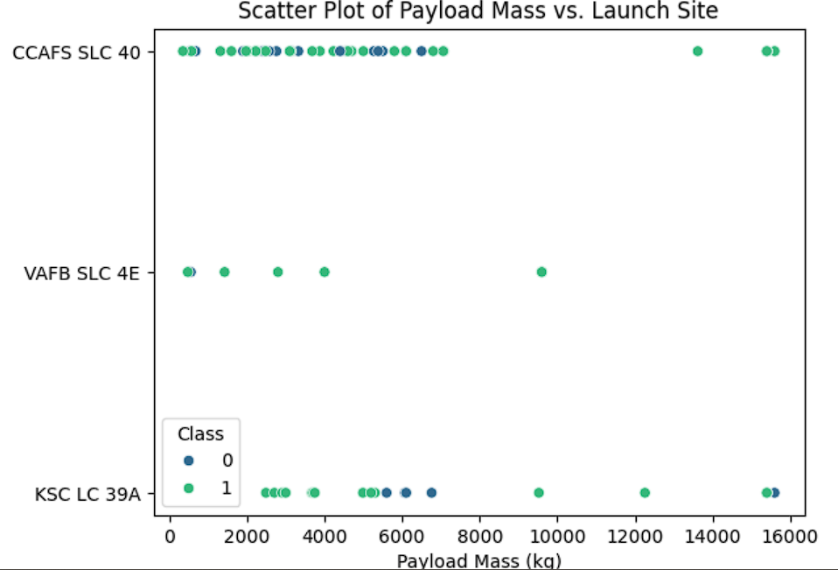
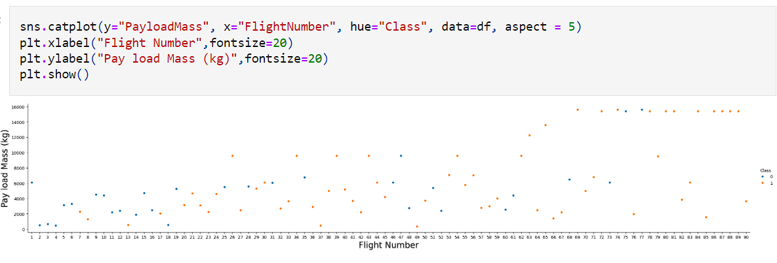
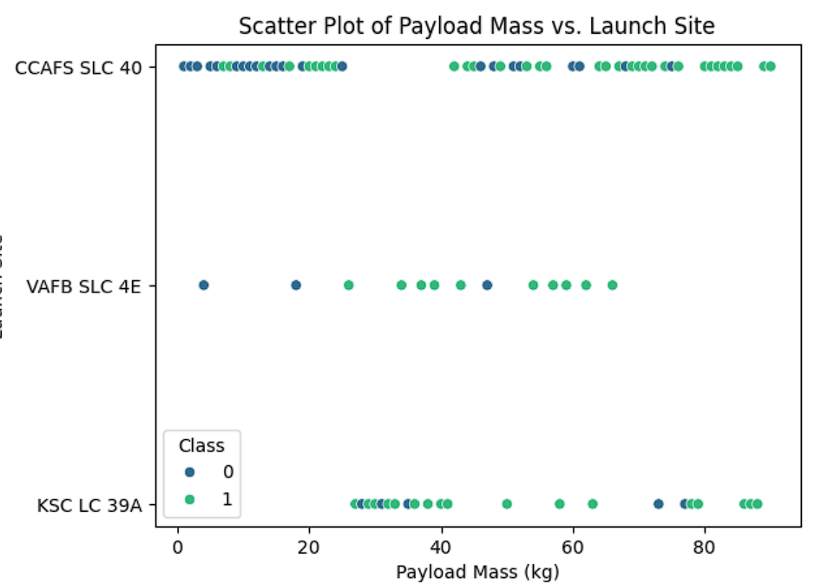
Results
Exploratory data analysis results

Slide 18
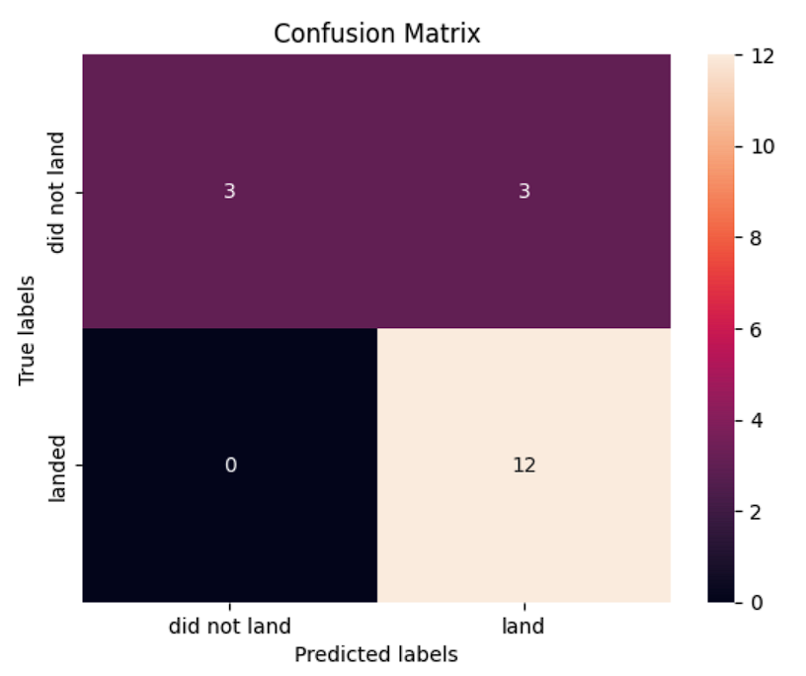
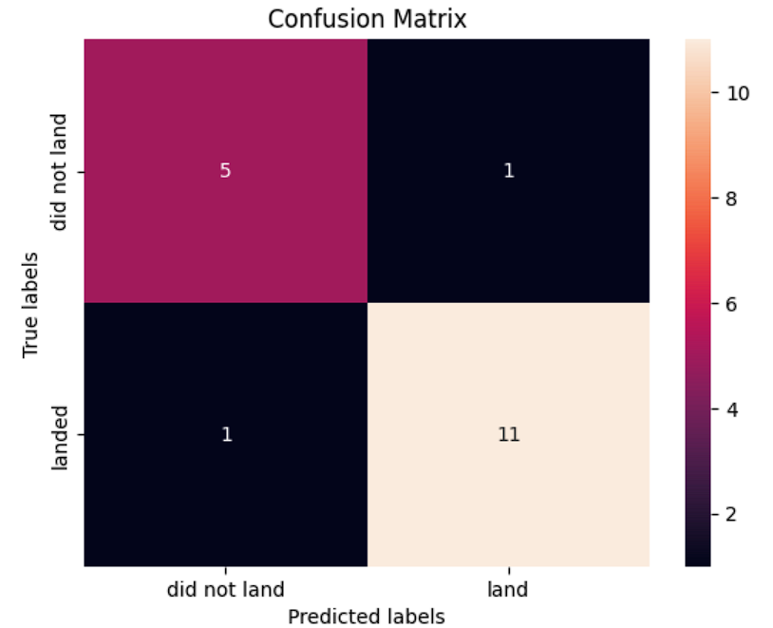
Results
Predictive data analysis results For logistic regression
For Classification Tree(88% accuracy)

Slide 19

Section 2

Slide 20
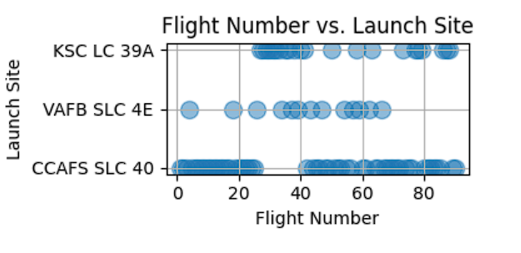
Flight Number vs. Launch Site
Scatter plot of Flight Number vs. Launch Site
Explanation- Here number of flights occurred continuously in CCAFS SLC 40 site from starting and it contains the major part of course. The least number of flights occurred in launching site of VAFB SLC 4E.

Slide 21
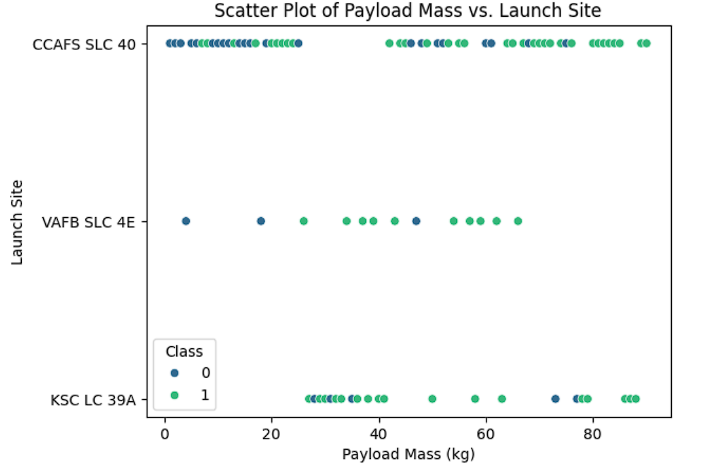
Payload vs. Launch Site
Scatter plot of Payload vs. Launch Site
Explanation- Here class 1 denotes successful launch and 0 denotes failed launch. We observe that least payload mass was flied from the launching site of VAFB SLC 4E and also very less in numbers but have high success rate. While highest payload was carried out from CCAFS SLC40 with low success rate for lower mases and higher for the higher payload masses.

Slide 22
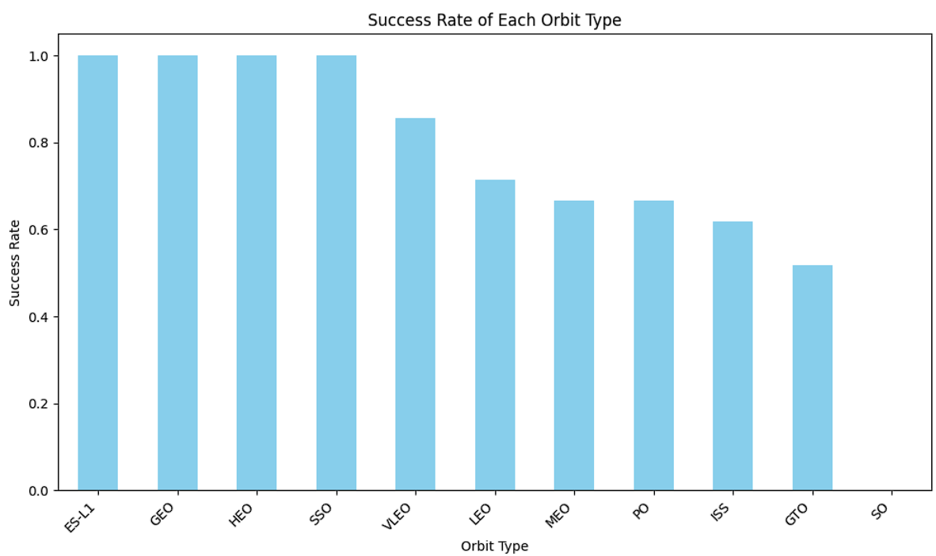
Success Rate vs. Orbit Type
Bar chart for the success rate of each orbit type
Explanation- Least success rate for SO and GTO orbits and best for ES-L1,GEO,HEO,SSO. We can consider these orbits for future rocket launchings.

Slide 23
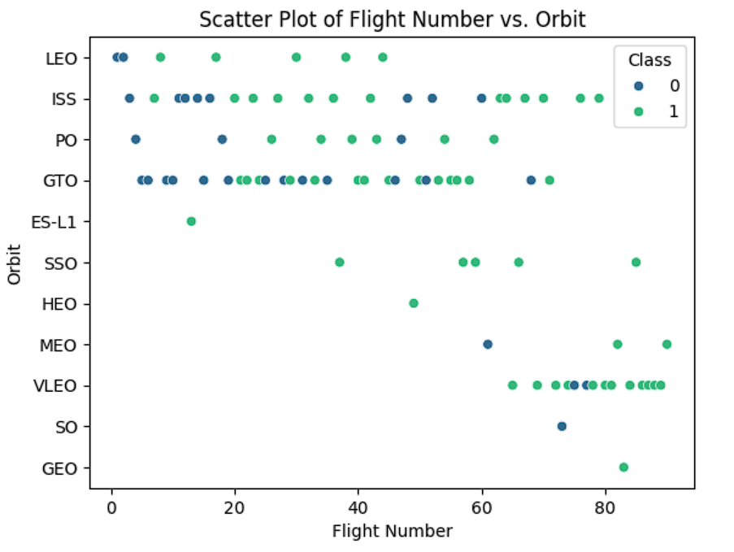
Flight Number vs. Orbit Type
Scatter Plot of Flight number vs. Orbit type
Explanation- We performed only one flight in the orbits of GEO and SO with success and failure respectively. We can observe that only one failure in VLEO orbit and we can consider it for future launchings.

Slide 24
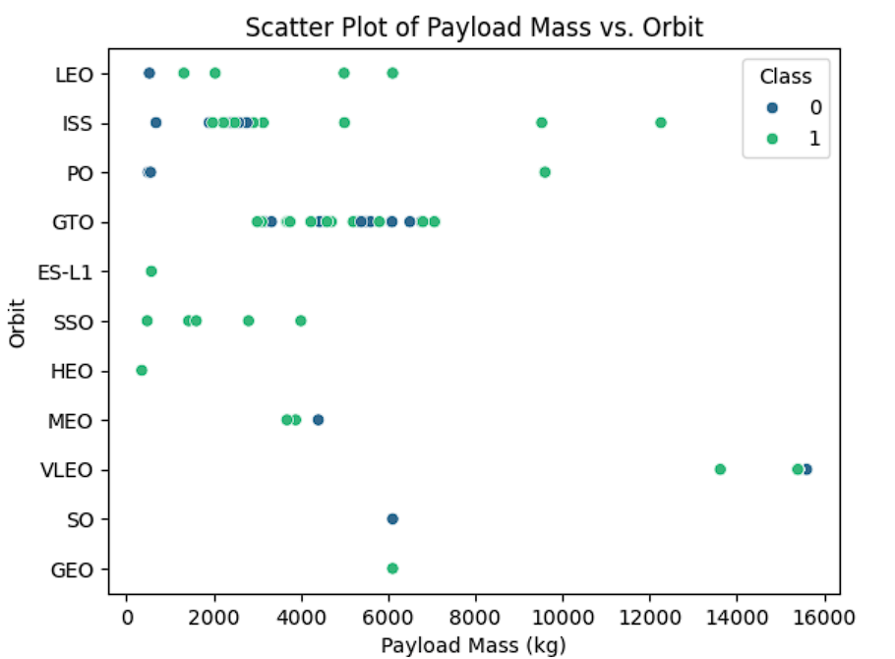
Payload vs. Orbit Type
Scatter plot of payload vs. orbit type

Slide 25
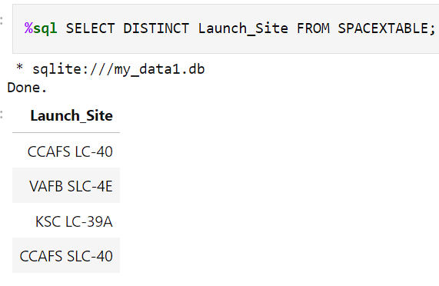
All Launch Site Names
Names of the unique launch sites:
Here we used sql magic by %sql command of line and selected the unique Launch_Sites from SPACEXTABLE.
And the result is shown in the picture

Slide 26
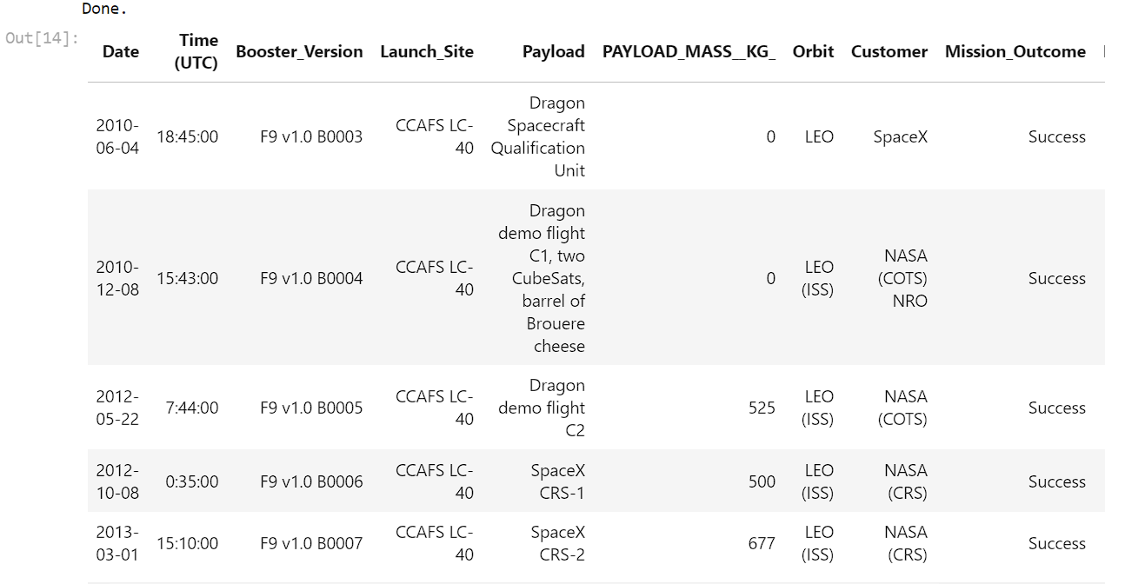
%sql SELECT * FROM SPACEXTABLE WHERE Launch_Site LIKE 'CCA%' LIMIT 5
Launch Site Names Begin with 'CCA'
5 records where launch sites begin with `CCA’:
We used the query:
%sql SELECT * FROM SPACEXTABLE WHERE Launch_Site LIKE ‘CCA%’ LIMIT 5

Slide 27
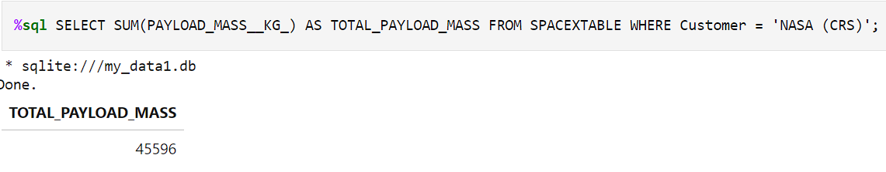
Total Payload Mass
Total payload carried by boosters from NASA
Explanation- The above picture shows the SQL input query with result for the total Pay Load Mass when the customer was NASA (CRS). We selected the SUM function to find the total sum of payload mass.

Slide 28
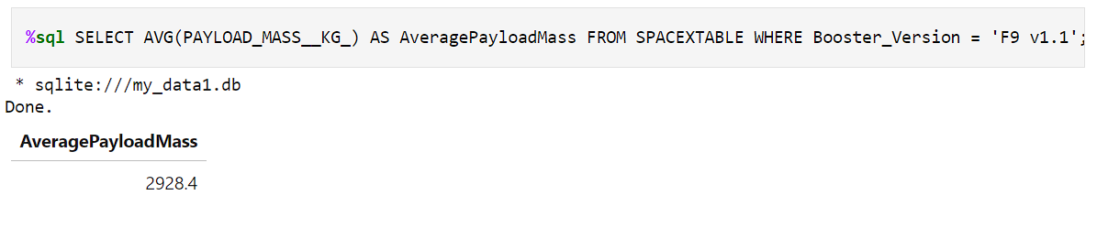
Average Payload Mass by F9 v1.1
The average payload mass carried by booster version F9 v1.1
Explanation- The above picture shows result i.e. ‘2928.4’ with query input for average Pay Load Mass when booster version was F9 v1.1.

Slide 29
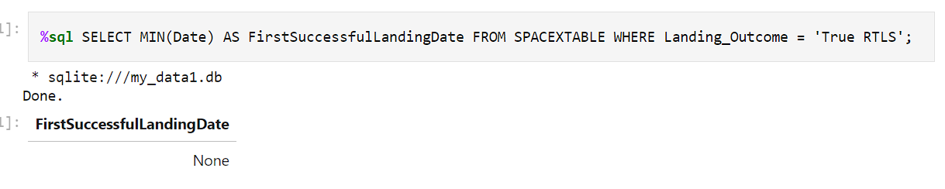
First Successful Ground Landing Date
Find the dates of the first successful landing outcome on ground pad

Slide 30
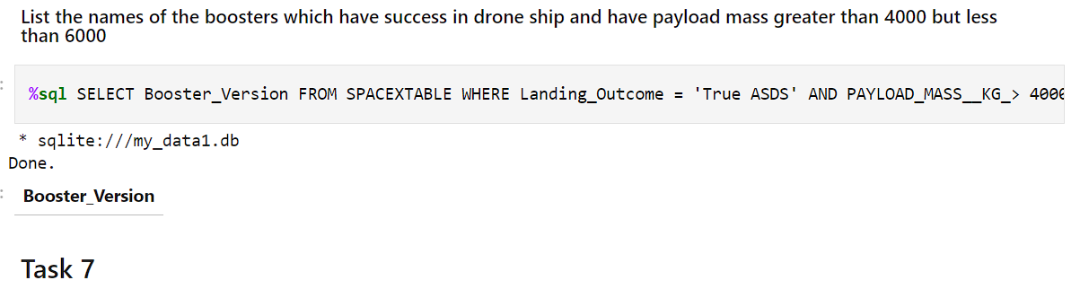
Successful Drone Ship Landing with Payload between 4000 and 6000
Names of boosters which have successfully landed on drone ship and had payload mass greater than 4000 but less than 6000

Slide 31
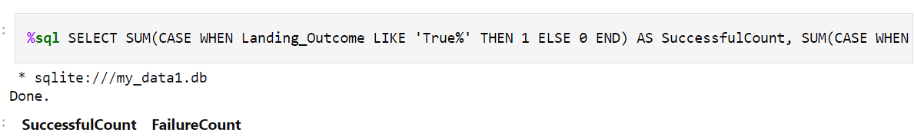

Total Number of Successful and Failure Mission Outcomes
The total number of successful and failure mission outcomes
62 28
Explanation- Above are the given counts for success and failed launches of falcon 9.

Slide 32
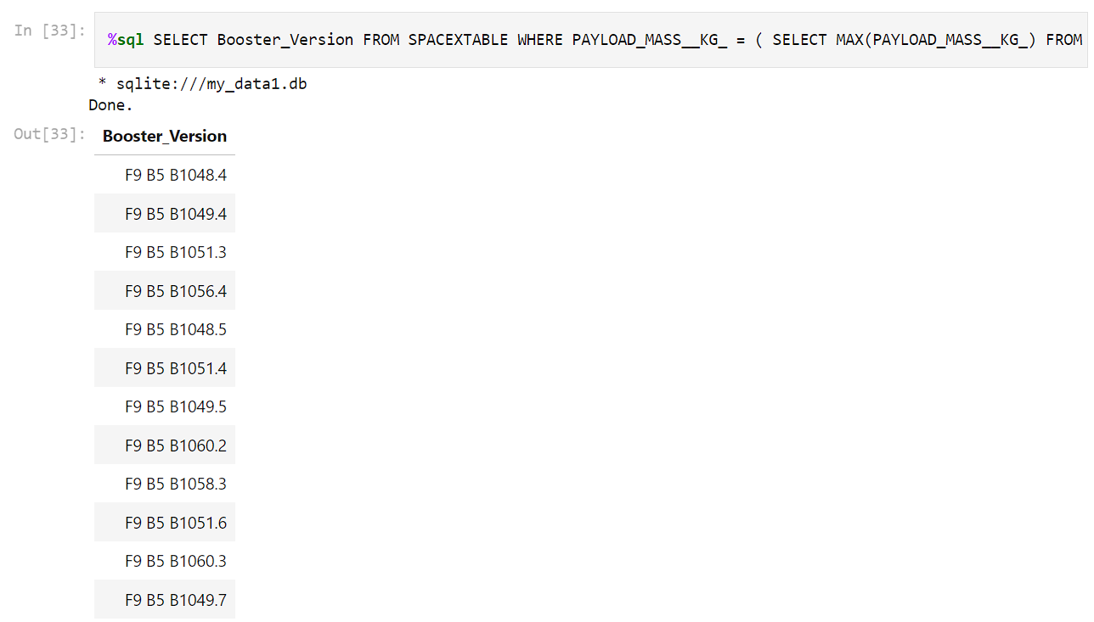
Boosters Carried Maximum Payload
Names of the booster which have carried the maximum payload mass

Slide 33
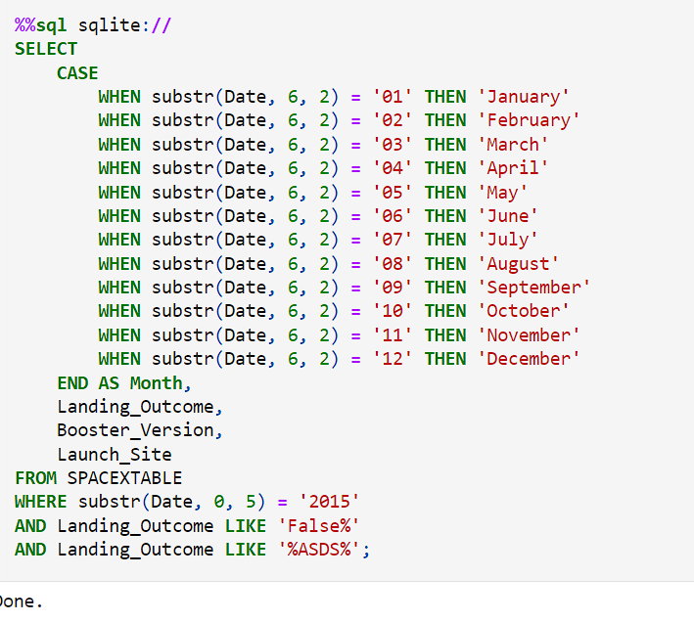
2015 Launch Records
Here is the query for the 2015 Launch Records:
Note- We used cases here for all the months in the year 2015

Slide 34
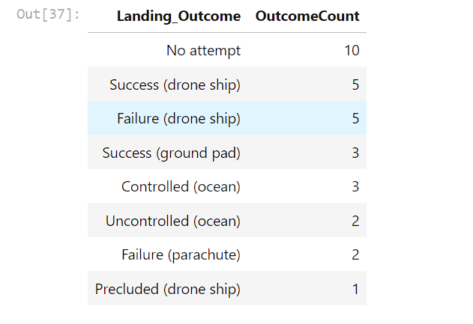
Rank Landing Outcomes Between 2010-06-04 and 2017-03-20
Landing outcomes (such as Failure (drone ship) or Success (ground pad)) between the date 2010-06-04 and 2017-03-20, in descending order
Expanation- We can observe that success and failure for drone ship is 5. Only one precluded that is for drone ship, for year 2015.

Slide 35

Section 3

Slide 36
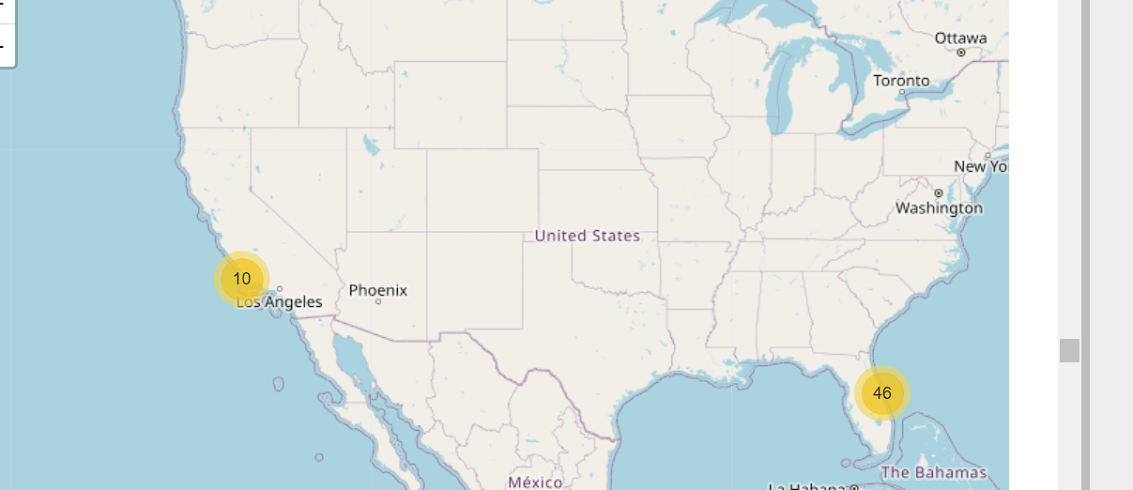
Where are the launch sites in the map?
Explore the generated folium map and make a proper screenshot to include all launch sites’ location markers on a global map
Explanation- First of all sites are in Florida in the right side and Los Angeles in left. We can see both the sites are chosen nearer the coastline area.

Slide 37
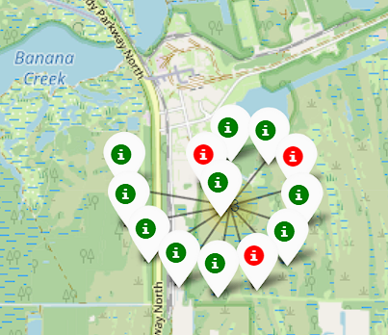
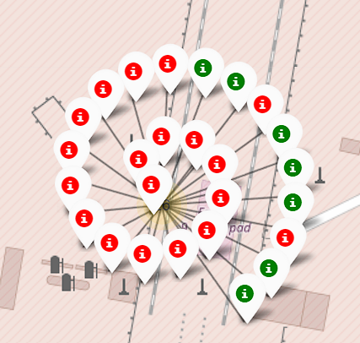
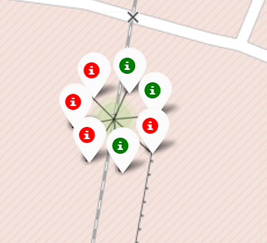
Launch Sites Near Florida
KSC LC-39A CCAFS LC-40 CCAFS SLC-40
Explanation- Green markers are the successful launches from the particular site and red for failed launch.

Slide 38
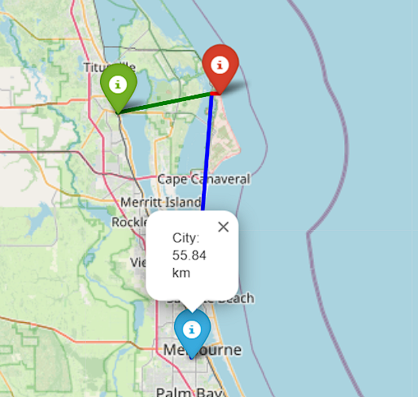
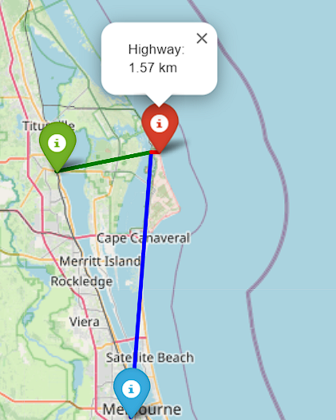
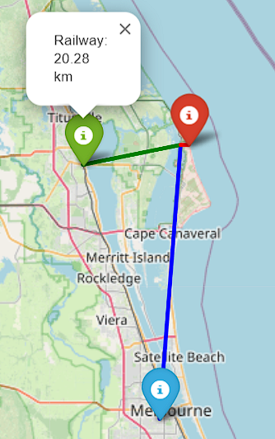
Representing near city, highway and railway from launch site:

Slide 39

Section 5

Slide 40
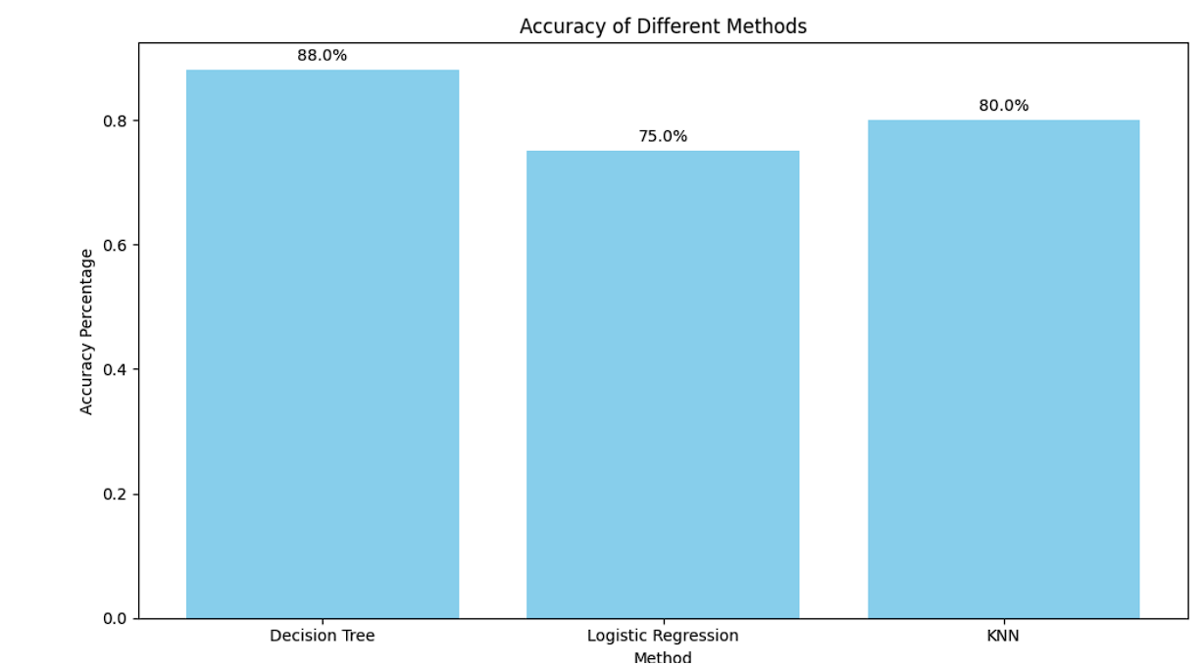
Classification Accuracy
Visualize the built model accuracy for all built classification models, in a bar chart
Explanation- We have the best method which is Decision Tree having the accuracy 88% and least accuracy of 75%.

Slide 41
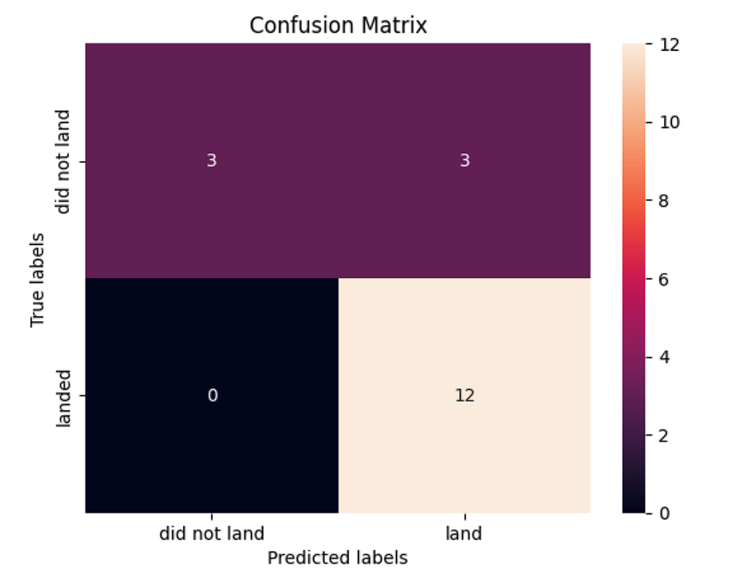
Confusion Matrix
Show the confusion matrix of the best performing model with an explanation
Description- The ideal scenario is on the diagonal, where 12 landed labels were correctly predicted as landed and 2 did not land labels were correctly predicted as did not land. There were misclassifications though, with 3 landed labels being predicted as did not land and 10 did not land labels being predicted as landed. Overall, the model seems to be performing well because the majority of classifications (14) were correct, but it made some mistakes, particularly with misclassifying did not land labels.

Slide 42
Conclusions
Point 1- Classification Tree is the best predictive analysis for the acquired data of SPACEX Falcon9.
Point 2- ESL1,GEO, HEO, SSO are the considerable orbits for future launchings.
Point 3- Total Pay Load Mass Carried by boosters from NASA is 45596 KG.
Point 4- Average Pay Load Mass from booster version F9 v1.1 is 2928.4 KG.
Point 5- When Launch Site was CCAFS LC-40 orbit always got chosen as LEO resulted success.
Point 6- Although Classification Tree method is best in all but there is always a chance to maximize it.

Slide 43
Appendix
We have faced issue in the marking cluster part and also the representation part of distance calculated on map. We decoded the whole jupyter file again and then got to know where we did mistake.
We used KNN, Logistic Regression, SVM and Classification Tree approach in the predictive analysis.
Best Method was Classification Tree for the provided SPACEX Data.
I used word ‘We’ several times in the report but it actually means to ‘I’ but not used because it does not feel like professional.

Slide 44


